Slide 1
APOLOGETICS
IN ONE LESSON
almost
Ai1L.net
Lesson 22
“The copies of the New Testament have been corrupted beyond recovery”

Slide 2
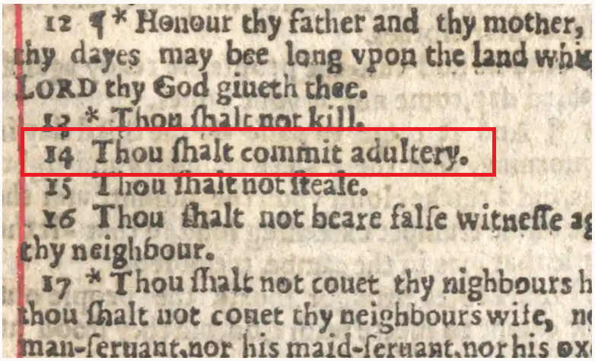

Slide 3
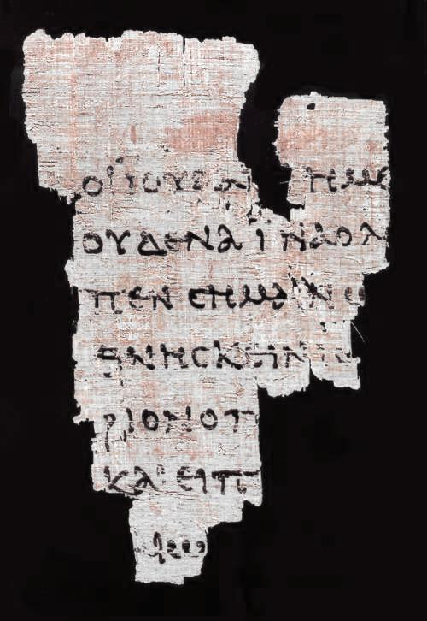
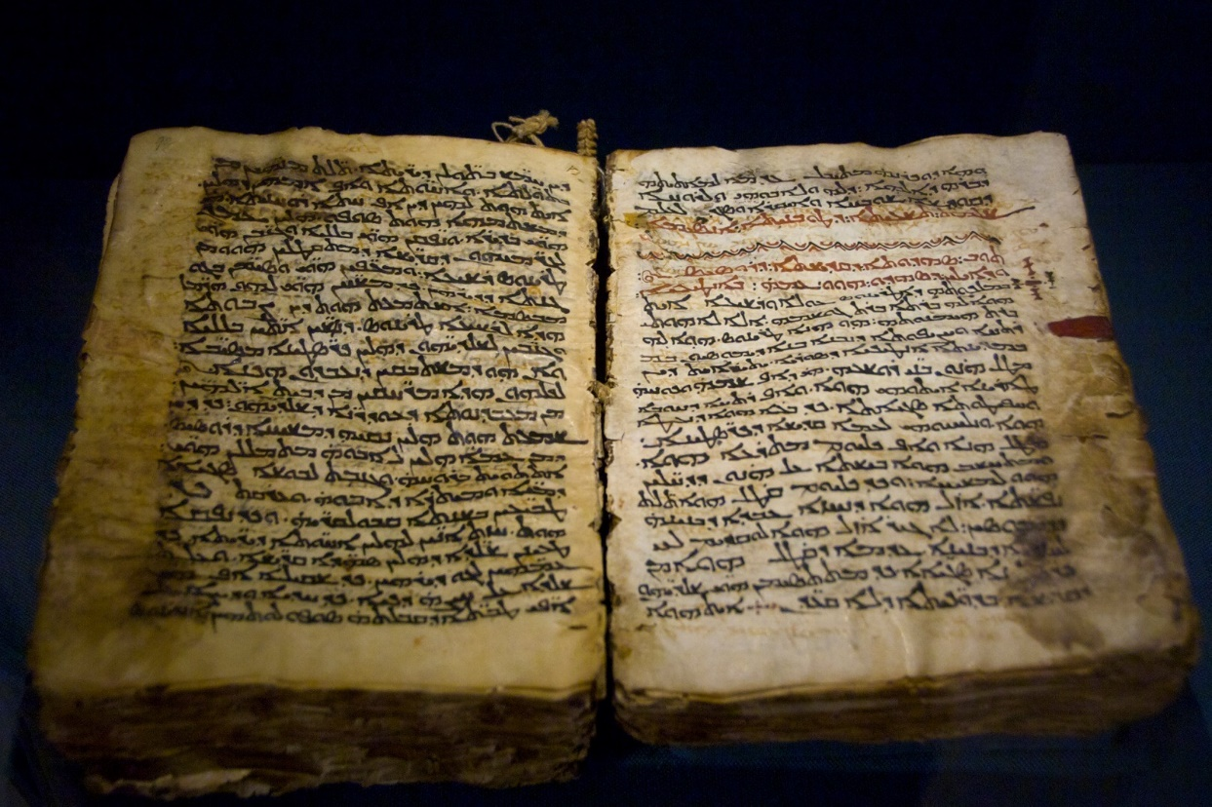
What is a manuscript?
Complete New Testament
Fragment

Slide 4
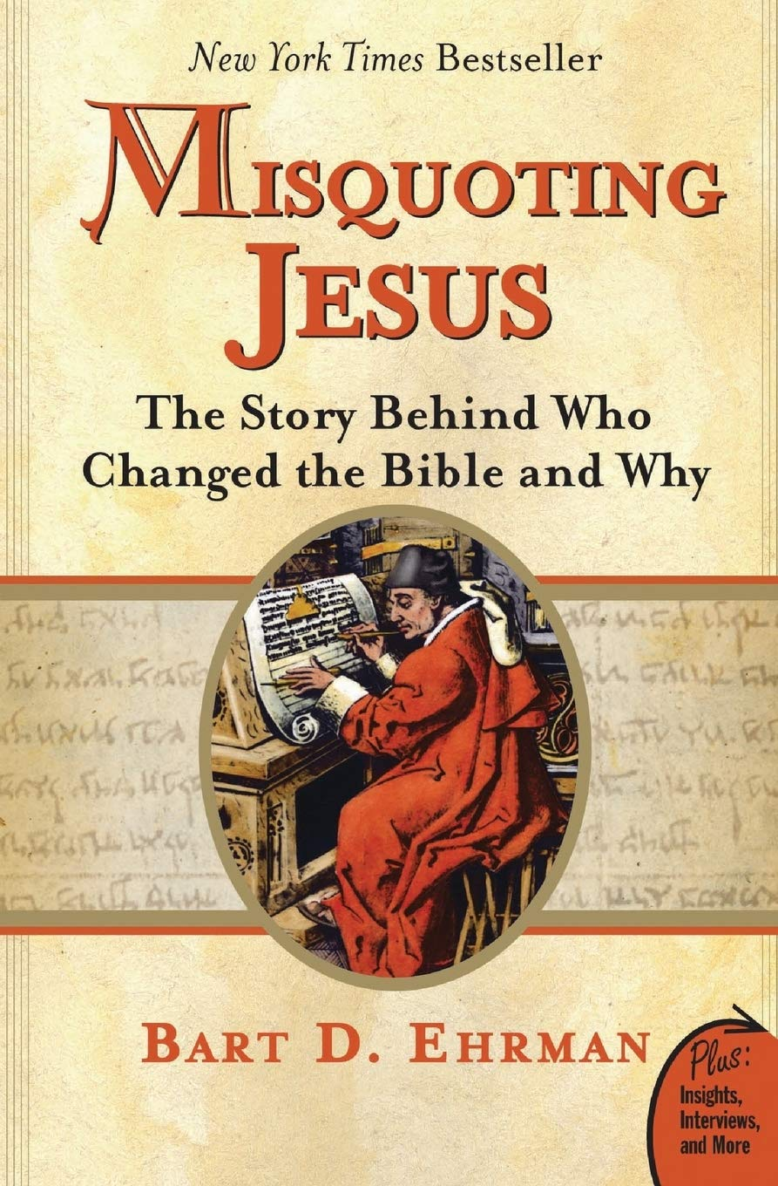
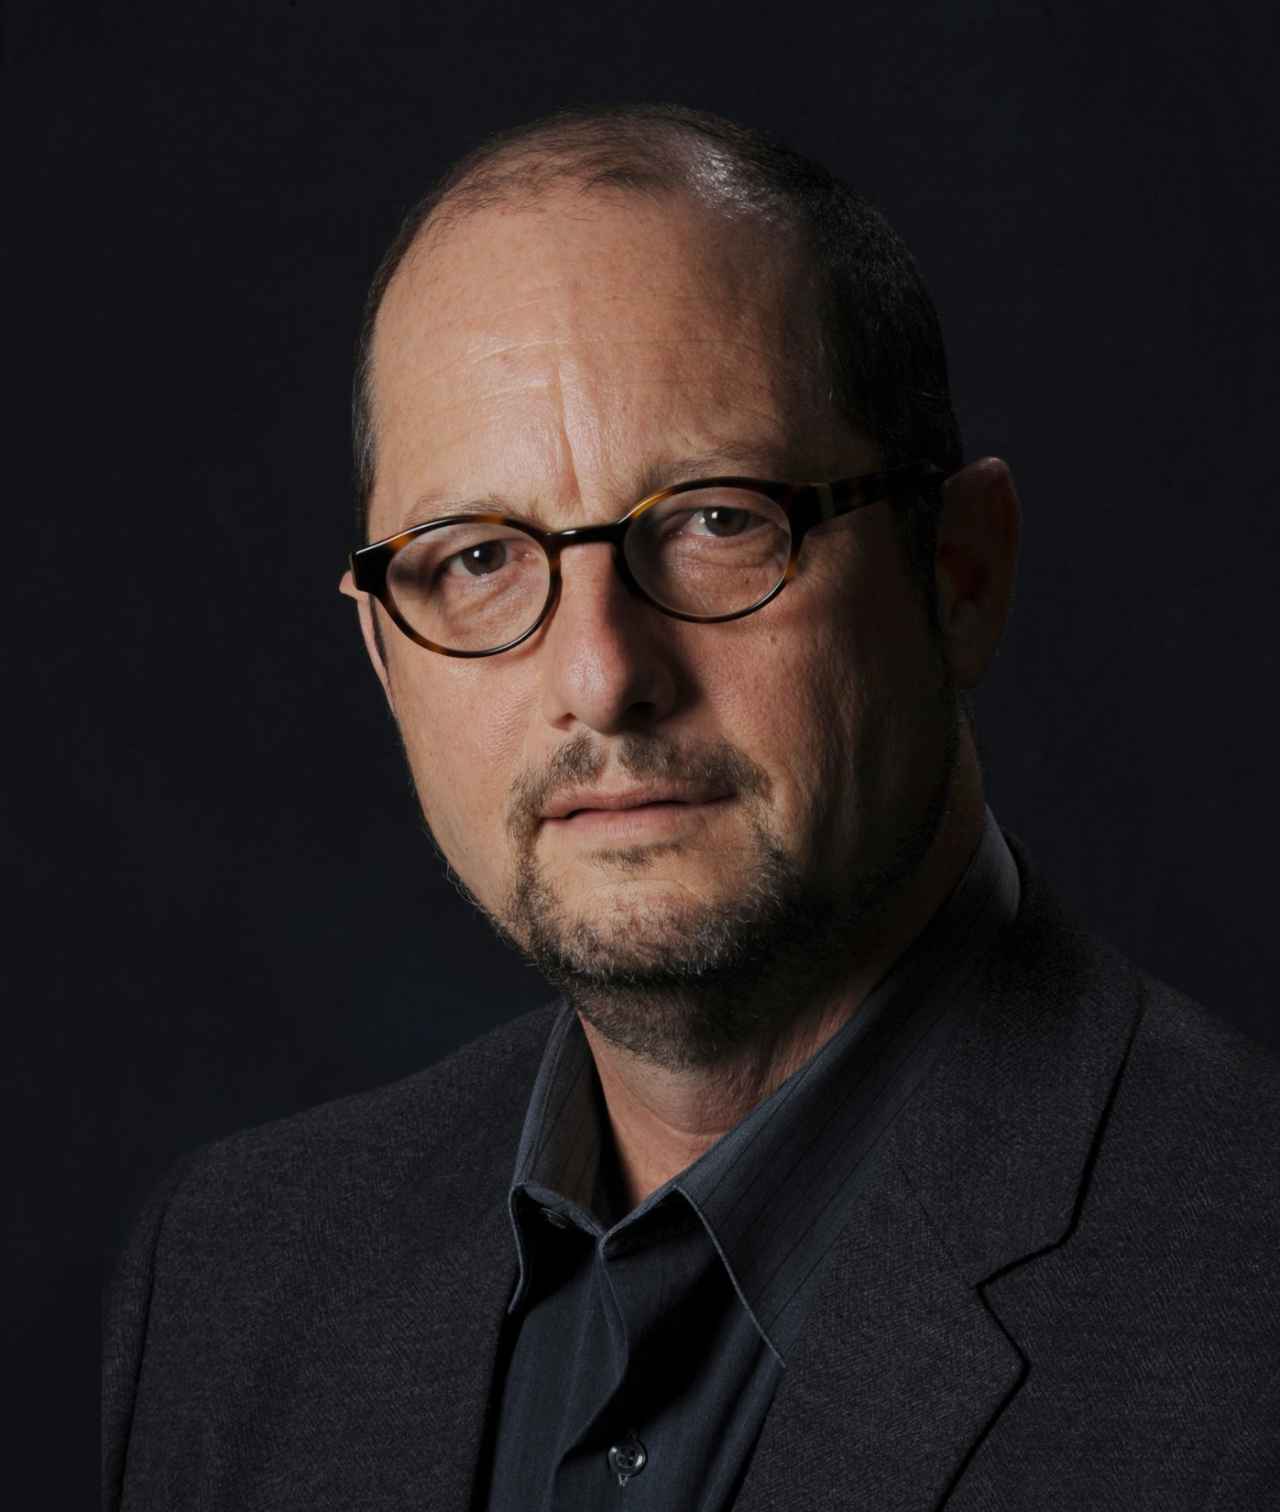

Slide 5
IDEA IN BRIEF
What?
Know how we can determine what the original accounts said despite not having the originals
Why?
To prevent people from being “blinded by science” regarding scribal errors
How?
By showing that:
Variations in the text aren’t critical
Ehrman overstates his claim (by quoting Ehrman)

Slide 6
I won a million dollars
0
I won one million dollars
1
I won $1 million
2
I won $1,000,000
3
I got $1,000,000
4
5
I wunwon a million dollars

Slide 7
Can we trust the manuscripts?
1
Variant counts rarely count for anything (and most don’t matter)
2
Scribal changes are hard to pass off without getting detected
3
New Testament documents are better attested that other ancient documents
4
Critical doctrines are not affected by variants (even Ehrman agrees)

Slide 8
Can we trust the manuscripts?
1
Variant counts rarely count for anything (and most don’t matter)
Most variants are unimportant (spelling changes, ordering differences, movable nu)

Slide 9
“John loves Mary” in Greek
1
Μαρίαν Ἰωάννης ὰγαπᾷ
2
Μαρίαν ὰγαπᾷ Ἰωάννης
3
Ἰωάννης Μαρίαν ὰγαπᾷ
4
Ἰωάννης ὰγαπᾷ Μαρίαν
5
Ἰωάννης Μαρίαν ὰγαπᾷ
6
ὰγαπᾷ Ἰωάννης Μαρίαν

Slide 10
Let’s add the article (i.e. “the”)
Combinations: | 24
Μαρίαν ό Ἰωάννης ὰγαπᾷ
Ἰωάννης Μαρίαν ὰγαπᾷ
ὰγαπᾷ ό Ἰωάννης τὴν Μαρίαν
Μαρίαν Ἰωάννης ὰγαπᾷ
Ἰωάννης τὴν Μαρίαν ὰγαπᾷ
ὰγαπᾷ Ἰωάννης Μαρίαν
Μαρίαν ὰγαπᾷ ό Ἰωάννης
Ἰωάννης ὰγαπᾷ Μαρίαν
ὰγαπᾷ Ἰωάννης τὴν Μαρίαν
Μαρίαν ὰγαπᾷ Ἰωάννης
Ἰωάννης ὰγαπᾷ τὴν Μαρίαν
ό Ἰωάννης τὴν Μαρίαν ὰγαπᾷ
τὴν Μαρίαν ό Ἰωάννης ὰγαπᾷ
ὰγαπᾷ Μαρίαν ό Ἰωάννης
ό Ἰωάννης ὰγαπᾷ Μαρίαν
τὴν Μαρίαν Ἰωάννης ὰγαπᾷ
ὰγαπᾷ Μαρίαν Ἰωάννης
ό Ἰωάννης ὰγαπᾷ τὴν Μαρίαν
τὴν Μαρίαν ὰγαπᾷ ό Ἰωάννης
ὰγαπᾷ τὴν Μαρίαν ό Ἰωάννης
ὰγαπᾷ ό Ἰωάννης Μαρίαν
τὴν Μαρίαν ὰγαπᾷ Ἰωάννης
ὰγαπᾷ τὴν Μαρίαν Ἰωάννης
ό Ἰωάννης Μαρίαν ὰγαπᾷ

Slide 11
Let’s add alternative spellings
Combinations: | 96
Μαρίαν ό Ἰωάννης ὰγαπᾷ
Μαρίαν Ἰωάννης ὰγαπᾷ
Μαρίαν ὰγαπᾷ ό Ἰωάννης
Μαρίαν ὰγαπᾷ Ἰωάννης
τὴν Μαρίαν ό Ἰωάννης ὰγαπᾷ
τὴν Μαρίαν Ἰωάννης ὰγαπᾷ
τὴν Μαρίαν ὰγαπᾷ ό Ἰωάννης
τὴν Μαρίαν ὰγαπᾷ Ἰωάννης
ό Ἰωάννης Μαρίαν ὰγαπᾷ
ό Ἰωάννης τὴν Μαρίαν ὰγαπᾷ
ό Ἰωάννης ὰγαπᾷ Μαρίαν
ό Ἰωάννης ὰγαπᾷ τὴν Μαρίαν
Ἰωάννης Μαρίαν ὰγαπᾷ
Ἰωάννης τὴν Μαρίαν ὰγαπᾷ
Ἰωάννης ὰγαπᾷ Μαρίαν
Ἰωάννης ὰγαπᾷ τὴν Μαρίαν
ὰγαπᾷ Μαρίαν ό Ἰωάννης
ὰγαπᾷ Μαρίαν Ἰωάννης
ὰγαπᾷ τὴν Μαρίαν ό Ἰωάννης
ὰγαπᾷ τὴν Μαρίαν Ἰωάννης
ὰγαπᾷ ό Ἰωάννης Μαρίαν
ὰγαπᾷ ό Ἰωάννης τὴν Μαρίαν
ὰγαπᾷ Ἰωάννης Μαρίαν
ὰγαπᾷ Ἰωάννης τὴν Μαρίαν
τὴν Μαρίαν Ἰωάνης ὰγαπᾷ
ὰγαπᾷ Μαρίαν ό Ἰωάνης
ὰγαπᾷ Ἰωάνης Μαρίαν
Μαρίαν ό Ἰωάνης ὰγαπᾷ
Ἰωάνης Μαρίαν ὰγαπᾷ
ό Ἰωάνης ὰγαπᾷ τὴν Μαρίαν
Ἰωάνης τὴν Μαρίαν ὰγαπᾷ
Ἰωάνης ὰγαπᾷ Μαρίαν
Ἰωάνης ὰγαπᾷ τὴν Μαρίαν
ό Ἰωάνης τὴν Μαρίαν ὰγαπᾷ
τὴν Μαρίαν ό Ἰωάνης ὰγαπᾷ
ὰγαπᾷ τὴν Μαρίαν Ἰωάνης
ὰγαπᾷ Μαρίαν Ἰωάνης
ὰγαπᾷ Ἰωάνης τὴν Μαρίαν
ὰγαπᾷ ό Ἰωάνης Μαρίαν
ό Ἰωάνης ὰγαπᾷ Μαρίαν
τὴν Μαρίαν ὰγαπᾷ ό Ἰωάνης
Μαρίαν Ἰωάνης ὰγαπᾷ
Μαρίαν ὰγαπᾷ Ἰωάνης
ό Ἰωάνης Μαρίαν ὰγαπᾷ
ὰγαπᾷ τὴν Μαρίαν ό Ἰωάνης
ὰγαπᾷ ό Ἰωάνης τὴν Μαρίαν
τὴν Μαρίαν ὰγαπᾷ Ἰωάνης
Μαρίαν ὰγαπᾷ ό Ἰωάνης
Ἰωάνης ὰγαπᾷ τὴν Μαριάμμην
ὰγαπᾷ Ἰωάνης Μαριάμμην
ὰγαπᾷ ό Ἰωάννης τὴν Μαριάμμην
ό Ἰωάνης ὰγαπᾷ τὴν Μαριάμμην
Μαριάμμην ό Ἰωάνης ὰγαπᾷ
ό Ἰωάννης ὰγαπᾷ τὴν Μαριάμμην
ὰγαπᾷ Μαριάμμην ό Ἰωάννης
ὰγαπᾷ Μαριάμμην Ἰωάννης
ό Ἰωάννης τὴν Μαριάμμην ὰγαπᾷ
Μαριάμμην ὰγαπᾷ ό Ἰωάνης
τὴν Μαριάμμην ὰγαπᾷ Ἰωάννης
ὰγαπᾷ τὴν Μαριάμμην Ἰωάννης
Ἰωάννης ὰγαπᾷ τὴν Μαριάμμην
ό Ἰωάνης ὰγαπᾷ Μαριάμμην
Μαριάμμην Ἰωάνης ὰγαπᾷ
τὴν Μαριάμμην ό Ἰωάννης ὰγαπᾷ
Ἰωάνης τὴν Μαριάμμην ὰγαπᾷ
τὴν Μαριάμμην Ἰωάννης ὰγαπᾷ
Μαριάμμην ὰγαπᾷ ό Ἰωάννης
Μαριάμμην Ἰωάννης ὰγαπᾷ
τὴν Μαριάμμην Ἰωάνης ὰγαπᾷ
ό Ἰωάνης Μαριάμμην ὰγαπᾷ
Ἰωάννης τὴν Μαριάμμην ὰγαπᾷ
Ἰωάνης ὰγαπᾷ Μαριάμμην
Μαριάμμην ὰγαπᾷ Ἰωάννης
ὰγαπᾷ Ἰωάνης τὴν Μαριάμμην
ὰγαπᾷ ό Ἰωάνης Μαριάμμην
τὴν Μαριάμμην ὰγαπᾷ Ἰωάνης
ό Ἰωάννης ὰγαπᾷ Μαριάμμην
Ἰωάννης Μαριάμμην ὰγαπᾷ
ό Ἰωάνης τὴν Μαριάμμην ὰγαπᾷ
τὴν Μαριάμμην ὰγαπᾷ ό Ἰωάννης
ὰγαπᾷ ό Ἰωάννης Μαριάμμην
Ἰωάνης Μαριάμμην ὰγαπᾷ
ὰγαπᾷ Μαριάμμην ό Ἰωάνης
Ἰωάννης ὰγαπᾷ Μαριάμμην
Μαριάμμην ὰγαπᾷ Ἰωάνης
ὰγαπᾷ τὴν Μαριάμμην ό Ἰωάννης
τὴν Μαριάμμην ὰγαπᾷ ό Ἰωάνης
ό Ἰωάννης Μαριάμμην ὰγαπᾷ
ὰγαπᾷ τὴν Μαριάμμην ό Ἰωάνης
Μαριάμμην ό Ἰωάννης ὰγαπᾷ
ὰγαπᾷ τὴν Μαριάμμην Ἰωάνης
ὰγαπᾷ Ἰωάννης Μαριάμμην
ὰγαπᾷ Ἰωάννης τὴν Μαριάμμην
ὰγαπᾷ Μαριάμμην Ἰωάνης
ὰγαπᾷ ό Ἰωάνης τὴν Μαριάμμην
τὴν Μαριάμμην ό Ἰωάνης ὰγαπᾷ

Slide 12
Variations of “John loves Mary”
That would be translated the same way in English

Slide 13
Can we trust the manuscripts?
1
Variant counts rarely count for anything (and most don’t matter)
Most variants are unimportant (spelling changes, ordering differences, movable nu)
The only variants that matter are those are viable (could be original)

Slide 14
Number of variants (by certainty)
From the United Bible Society (5th edition)
% of words¹
1.098%
1.159%
0.798%
0.015%
0.026%
¹ Assuming three words per variant. There are 138,020 words in the New Testament.

Slide 15
Number of variants (by certainty)
From the United Bible Society (5th edition)

Slide 16
Can we trust the manuscripts?
2
Scribal changes are hard to pass off without getting detected
Manuscripts were sent to many locations
Manuscripts were likely released within social networks
Early believers took modifications seriously

Slide 17
Can we trust the manuscripts?
3
New Testament documents are better attested that other ancient documents
New Testament manuscripts are: Earlier More numerous

Slide 18
Gap between date written and first available copies (smaller is better)

Slide 19
Number of manuscripts (larger is better)

Slide 20
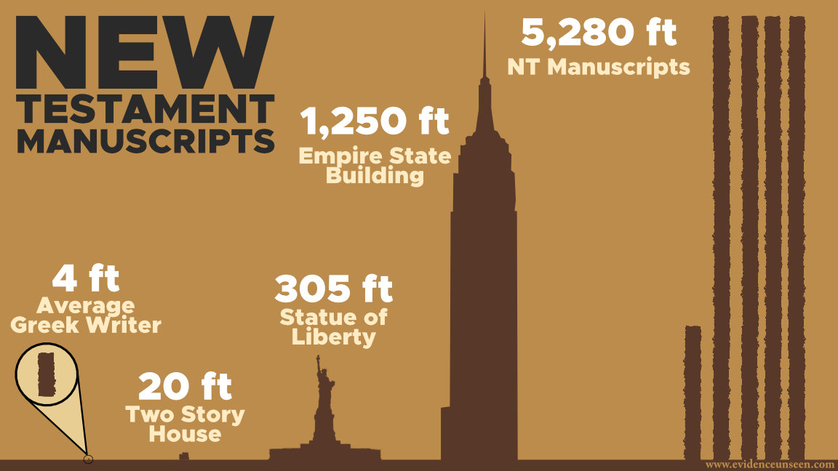

Slide 21
Can we trust the manuscripts?
4
Critical doctrines are not affected by variants (even Ehrman agrees)

Slide 22
“Bruce Metzger, your mentor in textual criticism to whom this book is dedicated, has said that there is nothing in these variants of Scripture that challenges any essential Christian beliefs.
Why do you believe these core tenets of Christian orthodoxy to be in jeopardy based on the scribal errors you discovered in the biblical manuscripts?”
Question to Bart Ehrman Misquoting Jesus

Slide 23
“there would be very few points of disagreement—maybe one or two dozen places out of many thousands. ”
Bart Ehrman Misquoting Jesus

Slide 24
“The position I argue for in Misquoting Jesus does not actually stand at odds with Prof. Metzger’s position that the essential Christian beliefs are not affected by textual variants in the manuscript tradition of the New Testament. ”
Bart Ehrman Misquoting Jesus

Slide 25
“none of your cherished doctrines appears to be in real danger because of variations in our surviving manuscripts (at least the variations that we know about). But that is not my claim and never has been my claim.”
Bart Ehrman

Slide 26
Summarize the critics' viewpoint
1

Slide 27
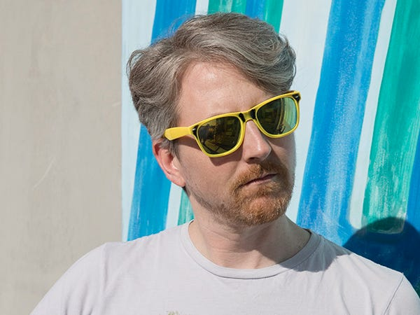
Joe Avella
Video Producer
The source of this video:
Joe is a video producer based in Los Angeles. He primarily focuses on food, marijuana, and movie industry stories.
https://www.businessinsider.com/author/joe-avella

Slide 28
List out the claims
2

Slide 29
What questions would you ask this person?
3

Slide 30
“of Christ Jesus”
“of Christ”
“of Christ Jesus”
“of Christ”
“of Christ”
“of Christ”
“of Christ”
“of Christ Jesus”

Slide 31
?
“of Christ”
“of Christ”
“of Christ”
Copyist
error
“of Christ”
“of Christ”
“of Christ Jesus”
“of Christ Jesus”
“of Christ Jesus”

Slide 32
Variants by type
Not all variants are made the same

Slide 33
“that their hearts may be comforted, having been knit together in love, and into all riches of the full assurance of understanding, and that they may have a complete knowledge of the mystery of God, namely Christ”
Colossians 2:2

Slide 34
Variant readings of Colossians 2:2

Slide 35
5,500+
Greek NT Manuscripts

Slide 36
over-confidence can lead
to hyper-skepticism
Over-confidence “there are no questions about the what was in the originals”
Realistic “we can have confidence about the what was in the originals (despite some questions)”
Hyper-skepticism “we have no clue what was in the originals!!!!!!!!!!”

Slide 37
Consider the top “ten missing verses”
4

Slide 38
Top 10 “missing verses”
1
1 John 5:7: “For there are three that testify: the Spirit, the water, and the blood”
2
John 8:7: “…‘Let him who is without sin among you be the first to cast a stone at her.’”
3
John 8:11: “’No one, Lord,’ she answered. ‘Then neither do I condemn you,” Jesus declared. ‘Now go and sin no more.’”
4
Luke 22:44: “He prayed more earnestly, and His sweat became like drops of blood falling to the ground”
5
Luke 22:20: “This cup is the new covenant in My blood… (uncontested in Matthew 26:28)

Slide 39
Top 10 “missing verses”
6
Mark 16:17: “In My name they will drive out demons; they will speak in new tongues;”
7
Mark 16:18: “they will pick up snakes with their hands, and if they drink any deadly poison, it will not harm them”
8
John 5:4: “for an angel of the Lord went down at certain seasons into the pool…”
9
Luke 24:12: Peter looks in the tomb and sees the cloths (uncontested in Mark 14:24)
10
Luke 24:51: “While He was blessing them, He left them and was carried up into heaven” (uncontested in John 20:3-7)

Slide 40
Key Takeaways
1
Variations do not affect crucial doctrines (even Ehrman agrees)
2
The details matter; but nuance is often lost leading to incorrect conclusions
3
The New Testament has an “embarrassment of riches” compared to other ancient works
4
The variations do not show an organized attempt to corrupt the New Testament

